Slide 1

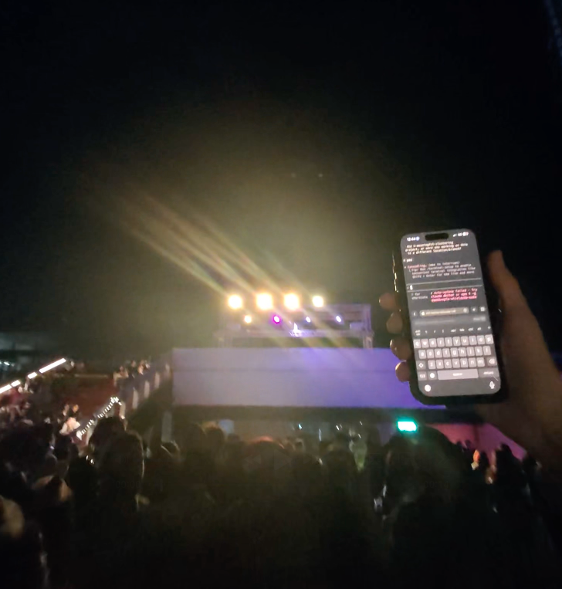



Ryan Bergamini, Tailscale Enthusiast
Coding from anywhere with https://github.com/rberg27/doom-coding

Slide 2
WHERE AI IS GOING
No boundaries, new interfaces
Coding from phone: https://youtu.be/xCd9ykretlg?t=119
AI-powered IoT: https://www.linkedin.com/posts/emollick_one-fun-thing-about-ai-is-that-it-lets-you-share-7448120269430378496-1qm6?utm_source=share&utm_medium=member_desktop&rcm=ACoAAGT9kLoBQFeolND_yAExZewoyrVfiKgkqRg
Building apps via text: https://www.anything.com/text
Adult In The Room → Adult On The Go
https://tailscale.com/blog/adult-in-the-room

Slide 3
Tailscale = the Vercel of Local
If AI is defining new interfaces, how can Tailscale be the go-to place to test?
Local testing → Reliable, Simple
Test an AI Application without figuring out hosting networking
Build a tutor via Claude Skills and local files - was able to test the app on the go by remoting to the terminal
Problems I experience:
Copying telnet address then adding the port to open the Browser
Creating a mobile DNS to use the Expo App without dynamically changing the database links
Could you build an Arduino tool to make IoT on tailscale easy
Owning your own intelligence
Open-Source Models, local compute, fine-tuned models
Tran

